Slide 1
Fig. 1
A
Group 1, 2 AIN93M
Group1: WT, AIN93M
Group2: Nrf2-/-, AIN93M
Group3: WT, 0.05% PEITC
Group4: Nrf2-/-, 0.05% PEITC
Group 3, 4 AIN93M
Group 3, 4 0.05% PEITC
X
X
Week 0 1 4
Gut microbiota equalization period (2 weeks)
B
C
Kingdom | Number of OTUs in Nrf2 KO Mice | Number of OTUs in WT Mice | Percent of OTUs in Nrf2 KO Mice | Percent of OTUs in WT Mice
Bacteria | 10,197 | 7,994 | 94.78% | 98.34%
Eukaryota | 472 | 116 | 4.39% | 1.43%
Unknown | 86 | 19 | 0.80% | 0.23%
Archaea | 4 | 0 | 0.04% | 0.00%
Notes:
LEGEND: study design(A), 16S sequencing depth per sample (B), and OUT counts and percentage by Kingdom within each genotype.

Slide 2
Fig. 2
Notes:
LEGEND: Shannon index was calculated for each sample as a measure of alpha diversity. The means and SEM are plotted here. Nrf2 KO mice had significantly more diverse microbiomes compared to WT (= 0.011).
NOTE: the original Figure 2 shows 2 more measures of alpha diversity but there is no need for it as it makes the inference more confusing. Additionally, number of OTUs (Fig 2 B) is proportional to sequencing depth – I believe Dr. Gao rarified her samples to correct for that but this approach have its pitfalls as it is a form of downsampling.
This figure also eliminates the need for Fig 5 as it provides same information ordered differently. Instead, a table of statistics should be added.

Slide 3
Fig. 3
A
B
C
D
Notes:
LEGEND: Biplots of samples projected to principal components 1 and 2. The arrows represent the direction and the magnitude of the effect of each bacterial Phylum (A), Class (B) or Genus (C and D) as measured by their relative abundance in the samples. Circles denote baseline samples (Week 0), squares – Week 1, and diamonds –Week 4 samples. The color-coded group labels are placed at the centers of each group (means in each dimension). Relative abundance of Firmicutes and Verrucomicrobia was higher in WT compared to Nrf2 KO, while Bacteroidetes, Protobacteria and Actinobacteria were more abundant in the Nrf2 KO mice (A). Bacteroidia represents the most abundant class of phylum Bacteroidetes while Clostridia and Bacilli are the most abundant classes of Firmicutes (B). At the Genus level, the samples are clearly separated by genotype in the PC1/PC2 space (C) but not by the treatment (D) or the timepoints (C and D shapes). Only the top 9 genus (by relative abundance in the samples) are shown in the plot.

Slide 4
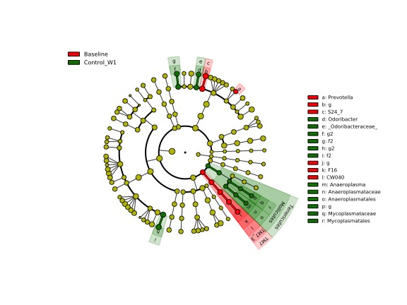
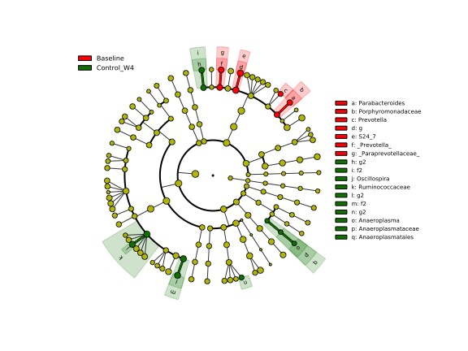
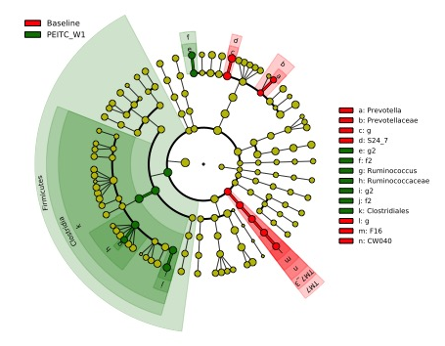
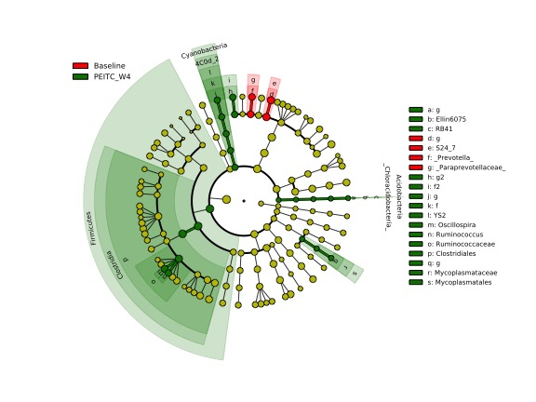
Fig. 4
A
B
C
D

Slide 5
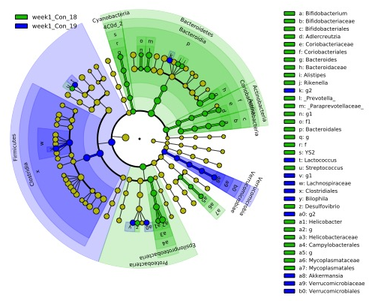
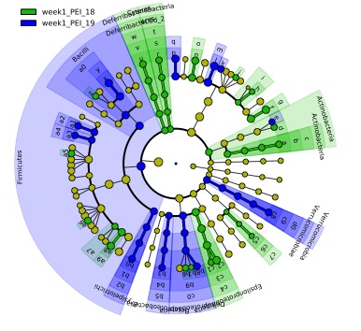
Fig. 5
A
B

Slide 6
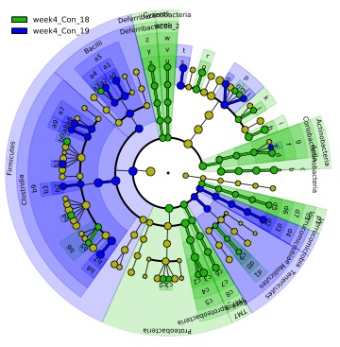
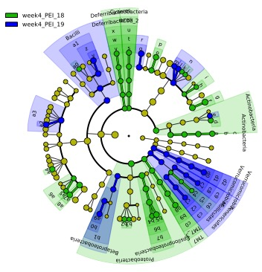
Fig. 6
A
B

Slide 7
Fig. 7
A
B
C
D
Notes:
Figure 7 Alternative: substituted individual data points in panel B with averages; corrected Week 5 to Week 4
LEGEND: Both, Bacteroidetes and Firmicutes were less abundant relative to other phylum in the WT samples compared to the Nrf2 KO (A), as well as at the baseline compared to later time points (B) but there was no clear separation observed in relation to the diet (C). On average, relative abundance of Bacteroidetes was higher than Firmicutes at all timepoints in the Nrf2 KO samples and at the baseline in the WT samples but equalized later (at weeks 1 and 4) in the WT.

Slide 8
Bacteroidetes/Firmicutes Analysis
Wile Type
Nrf2 KO
Term | Estimate | 95% C.I.L.L. | 95% C.I.U.L. | p-Value | Sign
Week 0 | 1.634 | 1.31 | 2.039 | <0.001 | **
Week 1 | 0.969 | 0.777 | 1.209 | 0.774
Week 4 | 1.009 | 0.809 | 1.259 | 0.933
PEITC/AIN93M | 0.998 | 0.73 | 1.365 | 0.992
Week 1:PEITC/Week0:AIN93M | 0.989 | 0.635 | 1.54 | 0.96
Week 4:PEITC/Week0:AIN93M | 1.089 | 0.7 | 1.696 | 0.694
Term | Estimate | 95% C.I.L.L. | 95% C.I.U.L. | p-Value | Sign
Week 0 | 2.097 | 1.467 | 2.995 | <0.001 | **
Week 1 | 1.891 | 1.539 | 2.324 | <0.001 | **
Week 4 | 1.393 | 1.134 | 1.712 | 0.002 | **
PEITC /AIN93M | 1.036 | 0.774 | 1.386 | 0.809
Week 1:DietPEITC/Week0:AIN93M | 0.757 | 0.501 | 1.143 | 0.179
Means and SEM of Bacteroidetes/Firmicutes Ratios
Genotype | Diet | Week 0 | Week 1 | Week 4
Wild Type | AIN93M | 1.66(0.15) | 0.97(0.04) | 1.04(0.12)
Wild Type | PEITC | 1.72(0.26) | 0.98(0.1) | 1.11(0.09)
Nrf2 KO | AIN93M |  | 2.02(0.27) | 1.43(0.12)
Nrf2 KO | PEITC |  | 1.52(0.11) | 1.51(0.15)
Nrf2 KO | Pooled | 2.15(0.35)

